Slide 1
WiT Hackathon - Synopsis
Women in Technology (WiT) an industry wide forum that focuses on empowering women in STEM
In partnership with IBM, the event was conducted for 3 days (June 4 - 6)
Ideas for solving any pertinent issues, for post-covid
400+ teams , 100 Organisations
CS Metrics:
19 Teams (70 associates)
2 Teams in top 15, 1 team Runner Up (Sour Punk)
6 Teams in Top 50
CFO Tech : 5 teams , 1 team in Top 50

Slide 2




Opportunity
Cost Benefits -Real estate & maintenance facilities
74 percent of CFOs surveyed by Gartner expect to continue working remotely after the pandemic ends.”
Positive impact to environment
Remote/Virtual working
Policies
Safe-Route
BCP
Planner
Real-Estate

Slide 3


Solution -
HERstory Makers
Sharmila M, Savitha Sridhara, Pavithra MP, Supriya Aithal

Slide 4






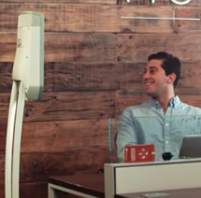

Features

Slide 5
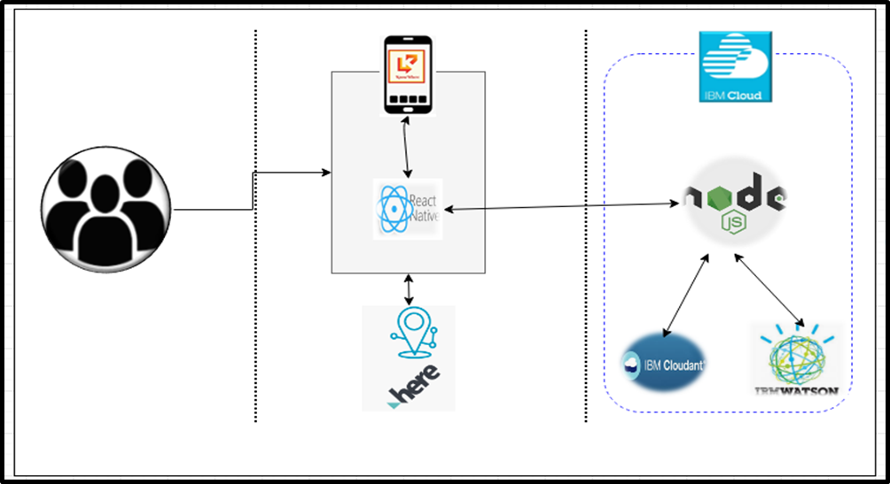
Technology
Users
IBM Cloudant : The NoSQL database used
IBM Cloud Functions : The compute platform for handling logic
IBM Watson : The AI platform used for Chabot
Here : The rich location data used for routing/location navigation
geoIQ : Real-time API provides list of containment zones for location/nodes
Node JS : The cross platform used as middle tier
React Native : The open-source framework used for mobile app

Slide 6
Roadmap
Wireframe
Launch App
1. Create mobile app
2. Integrate IBM Watson AI & Cloud services
3. Connect Datasources & API’s
1. Market app
Q2, 2020
Q4, 2020
Strategy, Analysis & Planning
Champion Adoption
Q3, 2020
Q4, 2020
1.Architecture & Design
1. Prototype with champion adopter
2. Monitor for results & opportunities

Slide 7

DEMO

Slide 8


